Slide 1

Neural Ordinary Differential Equations
Rammini Nipuni Senani de Silva
Department of Mathematics
Clarkson University, Potsdam
desilvr@clarkson.edu
March 7, 2023
‹#›
Notes:
From this presentation I’m going to give a simple explanation about Neural ODE

Slide 2
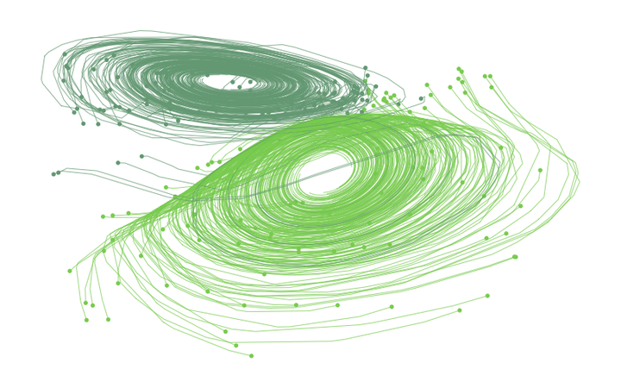
Content
ODEs and Solving ODEs
Neural ODEs
Neural ODE Simulations
‹#›
Notes:
First lets see how to solve an ODE generally and then we will move on to
Neural ODE model and then I’ll show you some simulations of it.

Slide 3
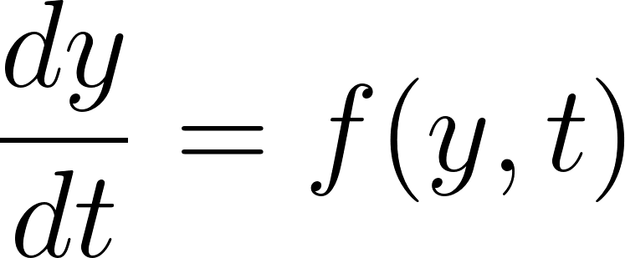
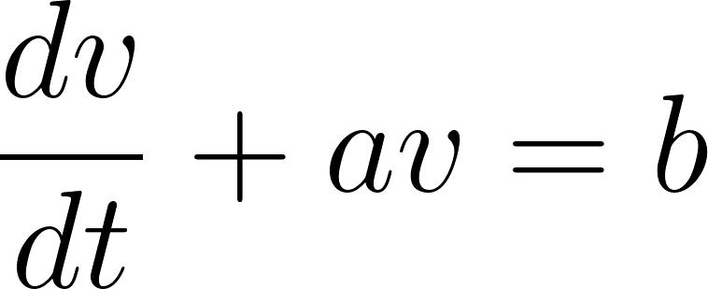
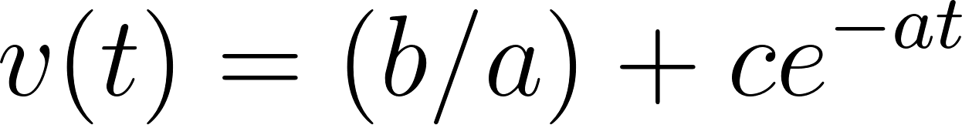






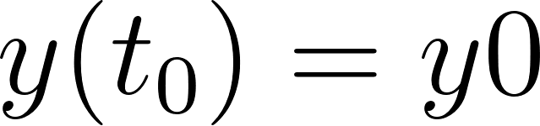

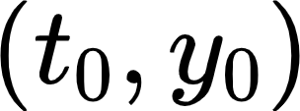
Ordinary Differential Equations
Analytical Solutions
Numerical Solutions
Analytical Solutions
Numerical Solutions
By using a numerical solver
Eg: Euler Method
where c is constant.
;
‹#›
Notes:
If we are given an ODE we can solve it from two different way .
1.Analytical Solution
This example shows how to solving an ODE using Integrating factor and we can get the solution analytically.
And
The next example show that we also can get an approximation to the solution of ODE using Numerical method such as Euler method.
—----------------------------------------------------------------------------------
These are the methods to solve an ODE if we know the what the differential Equation is
But what if we don’t know the dynamics or the ode of the function?
Let me answer this question with Neural ODE

Slide 4
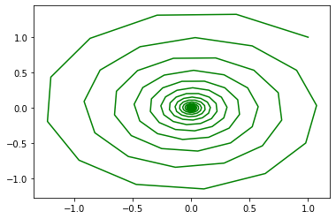
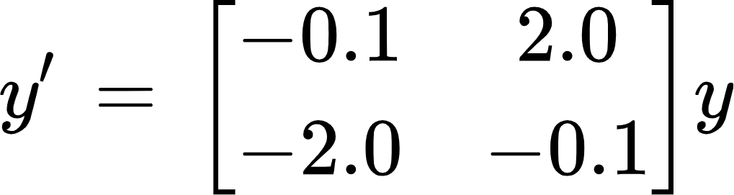
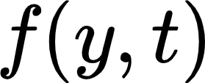
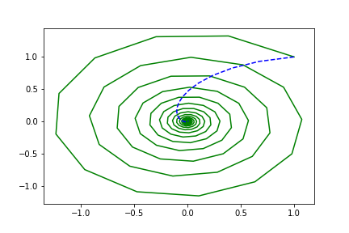
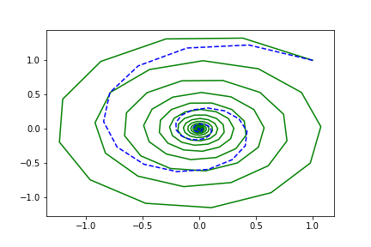
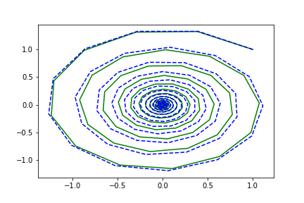
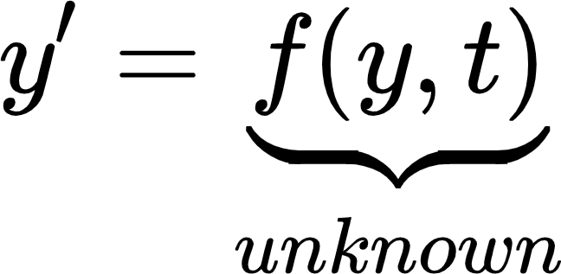
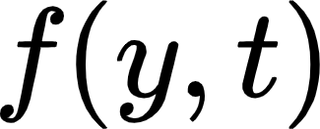
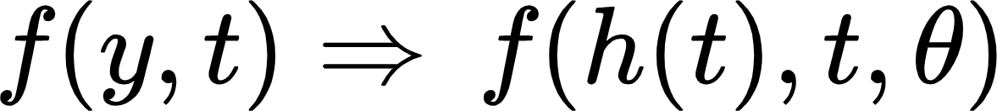
Neural ODEs
Neural Ordinary Differential Equations
Given system dynamics can be described using ODEs
We don’t know what the ODE model looks like
We have time series data which fit to this ODE model
We create a Neural Network to obtain the ODE model and use data to determine its parameters.
Neural ODE model
‹#›
Notes:
If we know that
dynamics of the system can be describe using ODE
And
We have lots of data which fit to this ODE model
But
We don’t know what the ode model look like
In this case we can train NN to get the RHS of the ODE of the given system.
I have experimental data that replicates this system (time series data)
#------------------------------------------------------------------------------#
This is the graphical representation of a spiral system.
The plots below it shows how how Neural ODE gives the approximation to the ode system as it was training.
Blue line show the Neural ODE output.

Slide 5


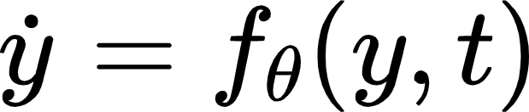
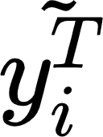
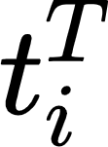
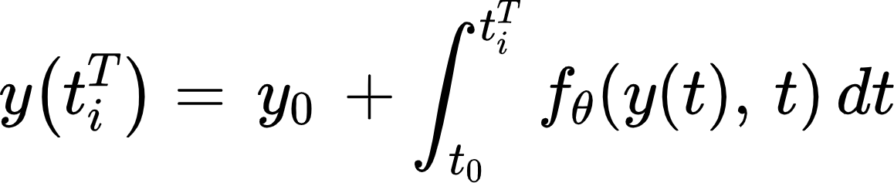
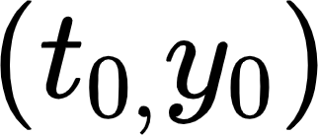
Neural Ordinary Differential Equations
;
Neural ODEs are class of models that parametrize the rate of change of the state with the help of Neural network .
NODEs predict the at such that
when IC given.
‹#›
Notes:
So ,Learning of NODE means learning the parameters of a NN which represent the the RHS of ODE system.
When we solving Numerical ODE , Ode solver requires an RHS of ode, IC, Time interval and tolerance.
Difference here is when solving using an neural ode is ode here is a NN.
The idea here is that we integrate the NN derivative by a ODE solver such as Euler , RK4 or Dormand–Prince (RKDP) method .
And get a trajectory as an output and tune the NN parameters until NN produce a trajectory that matches the data/ trajectory that has.

Slide 6
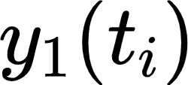
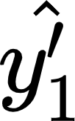
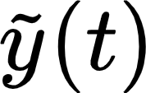
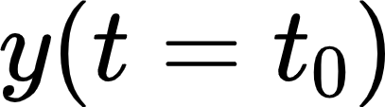
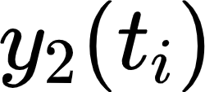
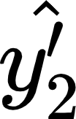
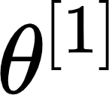
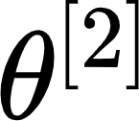



Neural ODEs: Implementation
Let the ODEs right hand side be a Neural Network.
ODE solver
Output:
Input:
t
‹#›
Notes:
This diagram shows How we train the Neural ODE to learn the parameters teta
Before I explain this process, i’ll talk about NN and how we usually train a NN.
#-------------------------------------------------------------------------------------------------------------#
The plots in the RHS shows the Neural ODE output with initial parameter values (blue line) and how it trying to fit to the system after some training iterations .
We give input and output over and over again.
Universal approximation theorem
We can learn the parameters of the dynamics f(z(t); t; ) using standard backpropagation through the
discretized version of the NODE. This approach is based on the observation that a discretized
NODE is itself a neural network. We demonstrate this procedure for the Euler method and
the midpoint method.

Slide 7
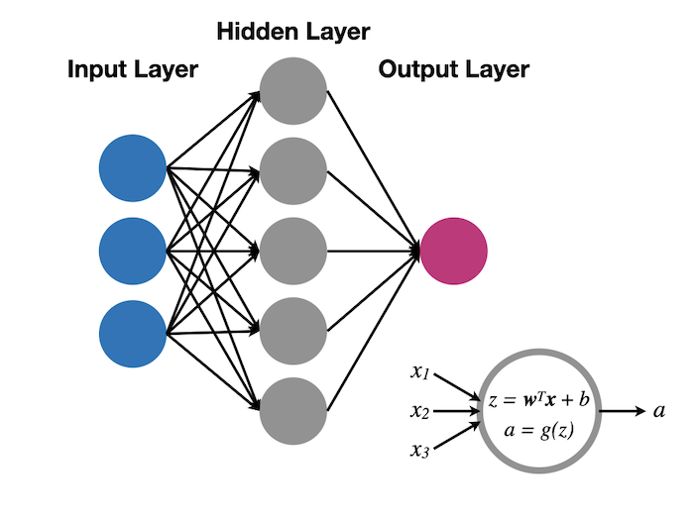
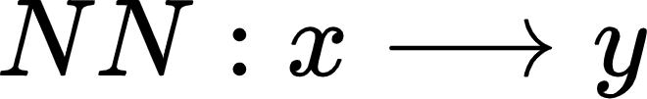









Neural Network Architecture
This neural network gives two dimensional output (y) to three dimensional input (x)
Input Layer
Output Layer
Nodes
‹#›
Notes:
NN is has the architecture as we can see in this picture .
We feed our data to input layer and process through the hidden layers and output layer execute the output.
Let me explain how this really happen inside the NN using this simple NN.
This NN contains only one layer . That is output layer.
Our target is to produce y from input x.
Let me explain what happened inside of a node

Slide 8

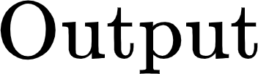

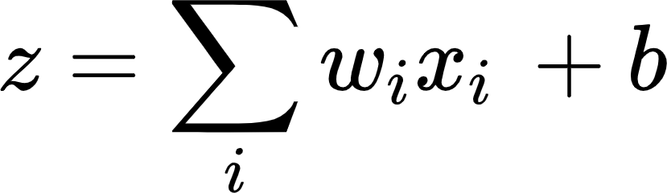
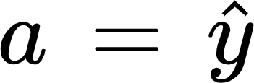

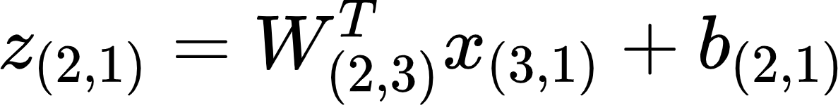

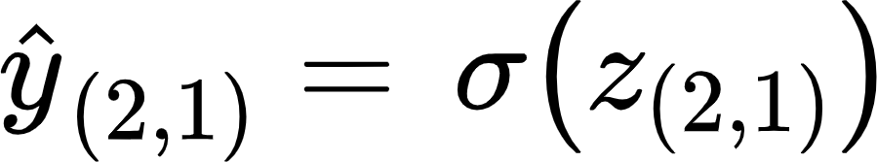

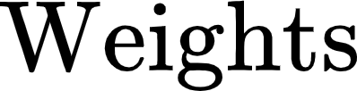


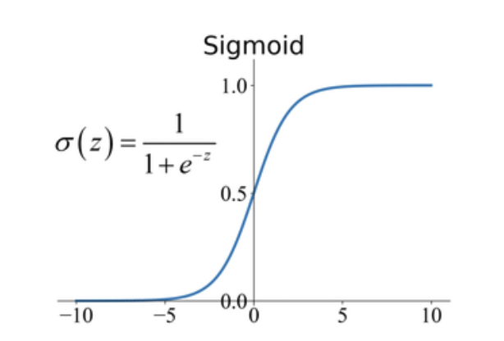
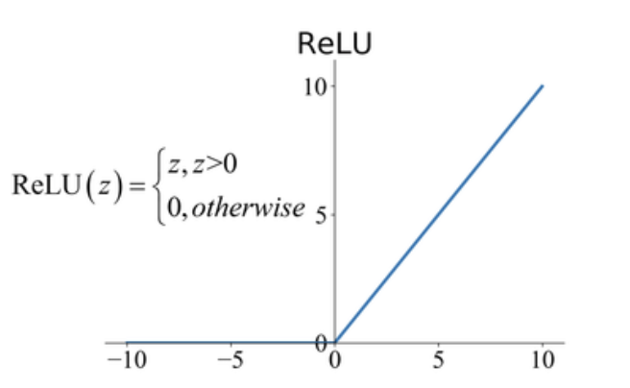
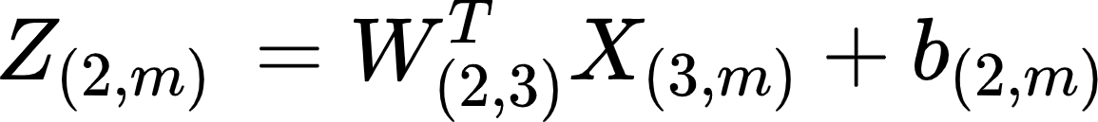
Neural Network Representation
For one input (column vector)
= Activation Function
Ex: Sigmoid Rectified Linear Unit
For m inputs
‹#›

Slide 9
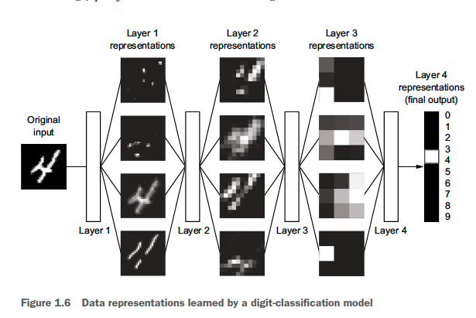
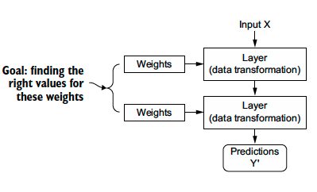

Training a Neural Network
Input X
adjusted
Weights
Layer 1 (Data Transformation)
Forward propagation
adjusted
Weights
Layer 2
(Data Transformation)
adjusted
Weights
Layer 3
(Data Transformation)
Optimizer
Prediction
True Target Y
Loss Function
Back propagation
‹#›
Loss score
Notes:
Assign random weights to each layers.
Loss function calculates how far is the nn output from the true target as a value:
Optimize how to minimize this loss score by changing weights using method called backpropagation.
we send the error backwards to update the weights this is a small adjustment compared to earlier values.
We go over this loop over and over again until we get correct accuracy : minimum loss we can obtain.

Slide 10
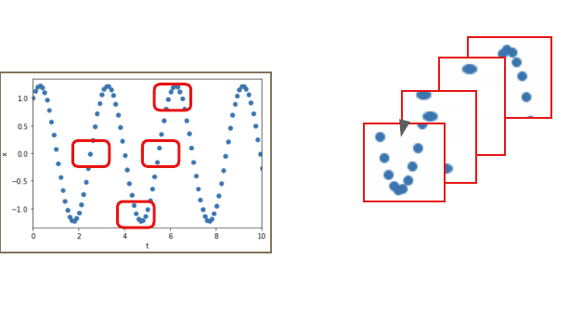
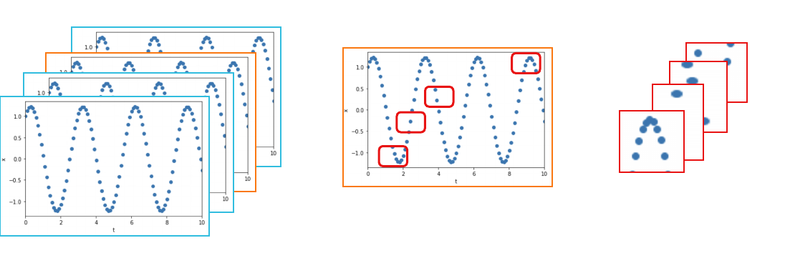
ODE : Training NODE
Data
We can train the Neural ODE model by taking one trajectory(one IC) of the system .
Train data:
for every training iteration, sequence of observed states of the trajectory at different points in time.
Validation data,Test data:
full trajectory generated by random IC.
We can train the Neural ODE model by taking multiple trajectories of the system.
Train data:
for every training iteration, sequence of observed states of a random trajectory at different points in time.
Validation data, Test data:
trajectory generated by random IC.
Batch
Batch
‹#›
Notes:
Now lets see how we can generate the data to train the Neural ODE. There are two ways.
We can take one trajectory to train if the system is periodic type and when training ,
For every training iteration, we get sequence of observed states of the trajectory at different points in time. We called this set of sequence a batch of data.
Second way of generate data is by getting multiple of trajectory instead of one.
And For every training iteration,choosing a random trajectory from it and then getting a batch of data just like in the previous case.

Slide 11
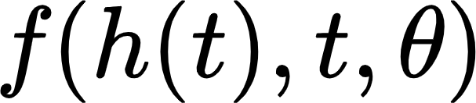
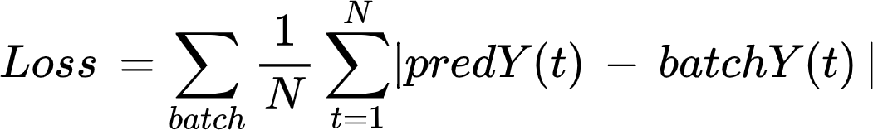
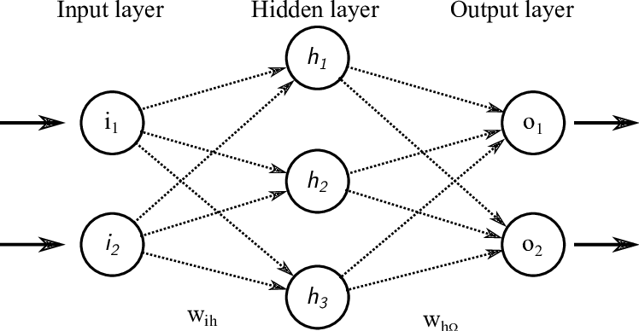

Neural ODE : Training the model
Algorithm:
Initialization: Setting up the Neural Network parameters with random weights
For each iteration from 1 to k
Forward pass:
Generate batch from train data
predY = ODESolver( , batchICs, batchTime, solver)
Loss computation:
Backward pass:
Backpropagation (Loss)
Parameter update:
Optimize by minimizing Loss
ODE solver
Input:
t
Output:
‹#›
Notes:
Batch:sequence of observed states of the trajectory at different points in time
Now let me show the full algorithm .
Algorithm:
First we Setting up the Neural Network parameters with random weights
And then for each iteration
Forward pass:
Given a sequence of observed states( batchY ), we compute the predicted states( predY ) by solving the ODE system using a numerical solver.
Loss computation:
Compute a loss function that measures the discrepancy between the predicted states and the true observed states. We used mean absolute error (MAE)
Loss = mean(| predY - batchY|)
Backward pass:
Compute the gradients of the loss function with respect to the network parameters using backpropagation.
Parameter update:
Update the network parameters using an optimization algorithm, such as stochastic gradient descent (SGD) or Adam, to minimize the loss function.

Slide 12
Neural ODE : Training the model
Algorithm:
Initialization: Setting up the Neural Network parameters with random weights
For each iteration
Forward pass:
Given a sequence of observed states( batchY ), compute the predicted states( predY ) by solving the ODE system using a numerical solver.
predY = ODESolver( , batchICs, batchTime, solver)
Loss computation:
Compute a loss function that measures the discrepancy between the predicted states and the true observed states. We used mean absolute error (MAE)
Loss = mean(| predY - batchY|)
Backward pass:
Compute the gradients of the loss function with respect to the network parameters using backpropagation.
Parameter update:
Update the network parameters using an optimization algorithm, such as stochastic gradient descent (SGD) or Adam, to minimize the loss function.
‹#›

Slide 13
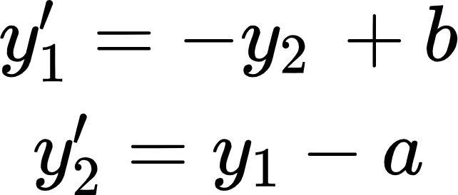
Neural ODE Simulations
Spiral System
Circle with center (a,b)
Depth of Network layers: 2,50,2
Activation functions: Tanh
Train data: Trajectory generated from Initial Conditions [0, 2]
Train data : 2000
Optimizer :RMSProp with lr = 1e(-3)
Epochs: 5000
Batch size: 24
Batch time: 10
Test data: Full trajectory
Depth of Network layers: 2,50,2
Activation functions: Tanh
Train data: Trajectory generated from Initial Conditions [8,1]
Train data : 500
Optimizer :RMSProp with lr = 1e(-3)
Epochs: 400
Batch size: 10
Batch time: 8
Test data: Full trajectory
‹#›

Slide 14
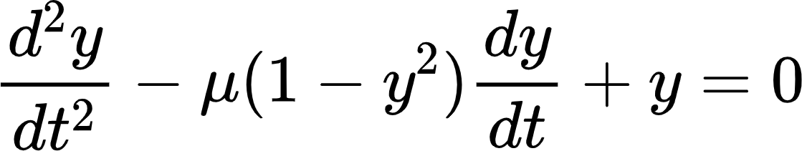
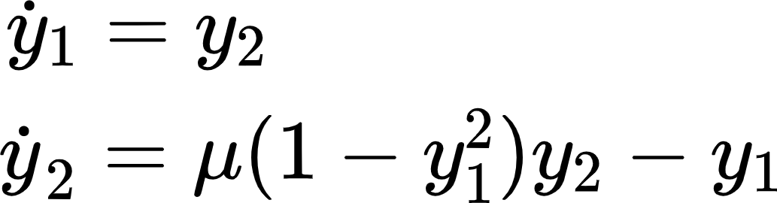
Neural ODE Simulations
Van der Pol Oscillator
Depth of Network layers: 2,50,2
Activation functions: Tanh
Train data: Trajectories generated from 10 random Initial Conditions
Train data : [10, 200]
Optimizer :RMSProp with lr = 1e(-3)
Epochs: 5000
Batch size: 24
Batch time: 10
Test data: trajectory generated from random IC
‹#›

Slide 15
‹#›
Notes:
As the conclusion ,

